Slide 1
John 2:1-11 Rod Thom

Slide 2
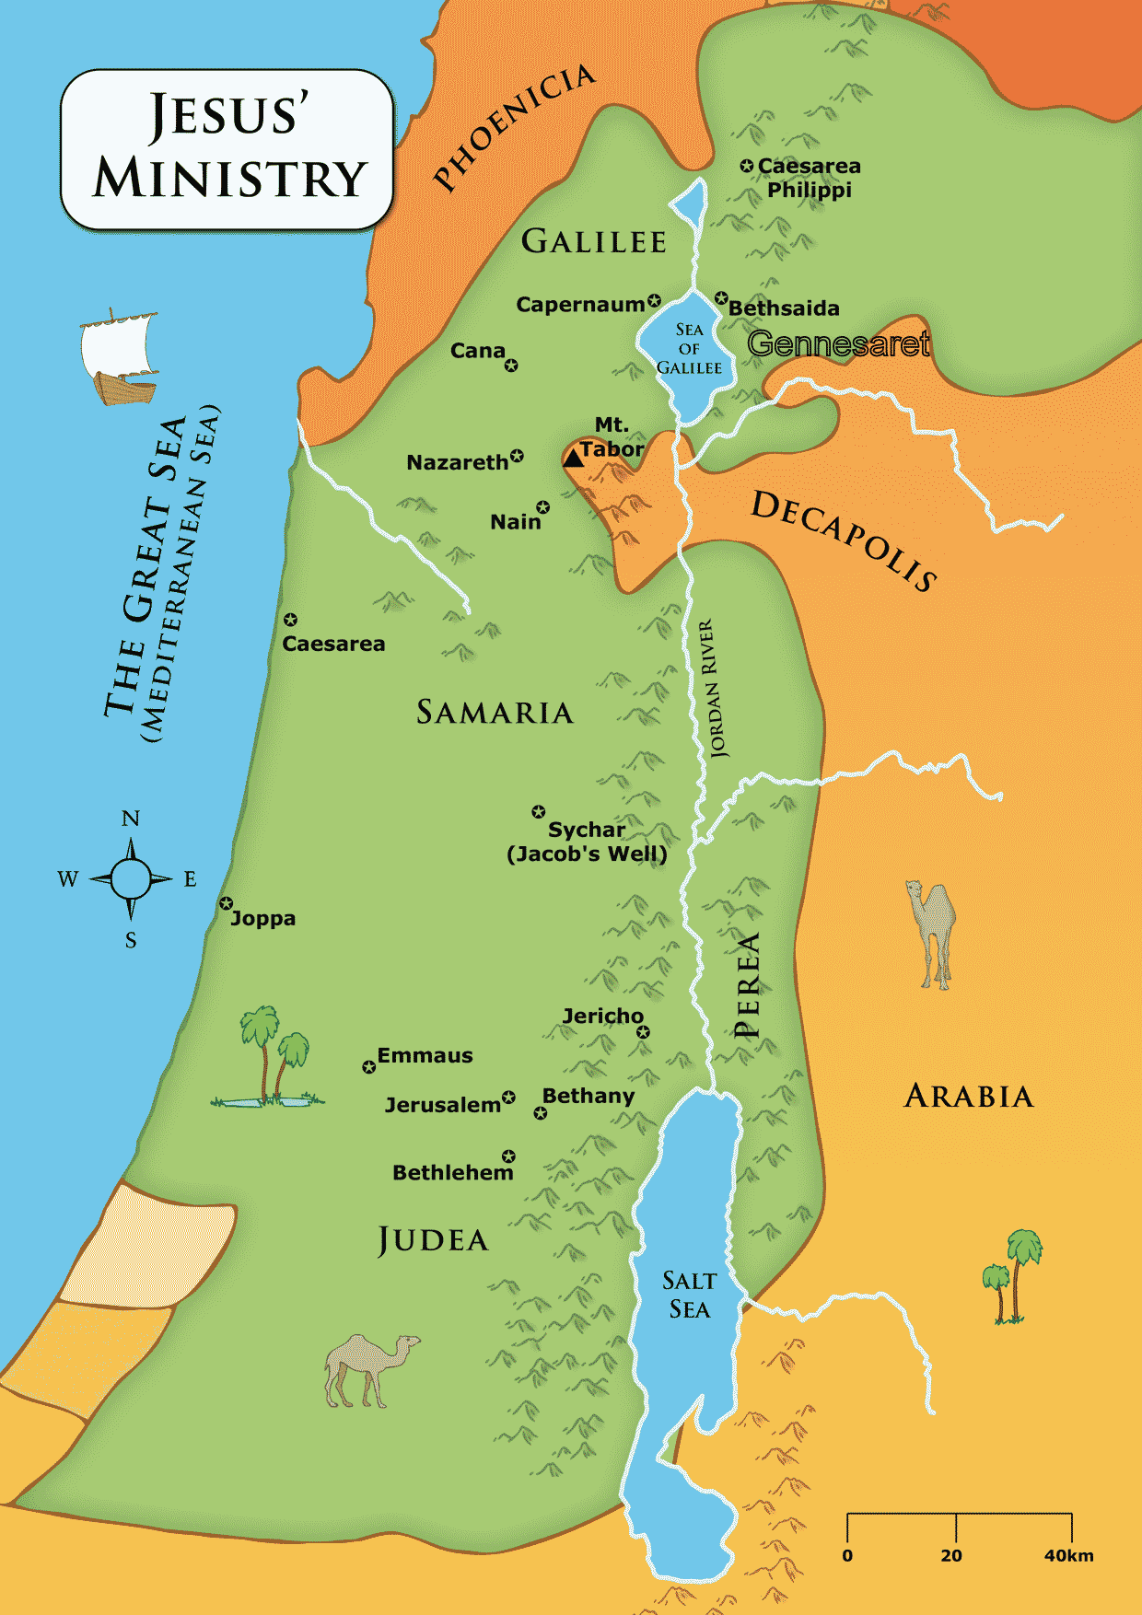

Slide 3
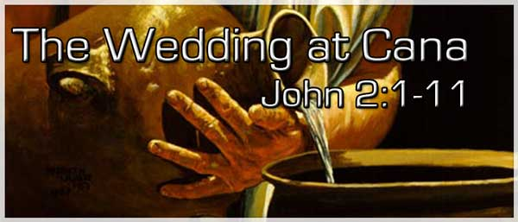
DIVINE WINE
John 2 (NIV) On the third day a wedding took place at Cana in Galilee

Slide 4
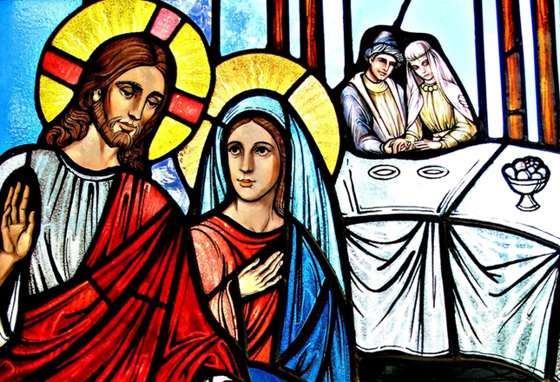
DIVINE WINE
Jesus’ mother was there, 2 and Jesus and his disciples had also been invited to the wedding.

Slide 5
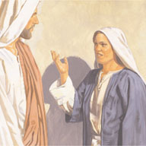
DIVINE WINE
3 When the wine was gone, Jesus’ mother said to him, “They have no more wine.”

Slide 6
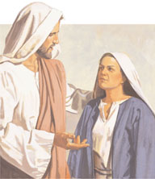
DIVINE WINE
4 “Woman, why do you involve me?” Jesus replied. “My hour has not yet come.”

Slide 7
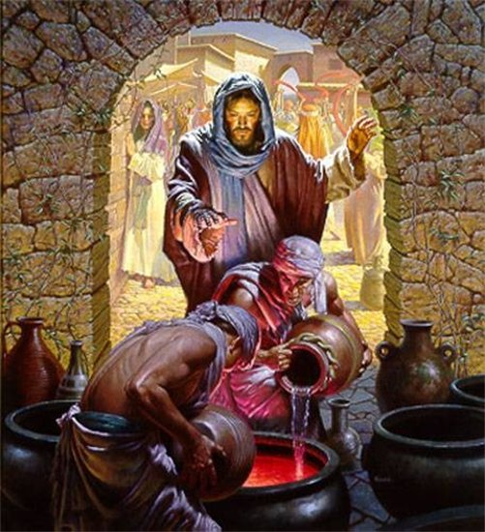
DIVINE WINE
5 His mother said to the servants, “Do whatever he tells you.”
6 Nearby stood six stone water jars, the kind used by the Jews for ceremonial washing, each holding from twenty to thirty gallons.[b]
7 Jesus said to the servants, “Fill the jars with water”; so they filled them to the brim.

Slide 8
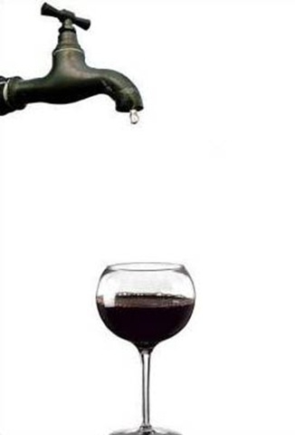
DIVINE WINE
8 Then he told them, “Now draw some out and take it to the master of the banquet.”
They did so, 9 and the master of the banquet tasted the water that had been turned into wine. He did not realize where it had come from, though the servants who had drawn the water knew.

Slide 9
DIVINE WINE
Then he called the bridegroom aside 10 and said, “Everyone brings out the choice wine first and then the cheaper wine after the guests have had too much to drink; but you have saved the best till now.”

Slide 10
DIVINE WINE
11 What Jesus did here in Cana of Galilee was the first of the signs through which he revealed his glory; and his disciples believed in him.

Slide 11
DIVINE WINE
John 20:30 Jesus performed many other signs in the presence of his disciples, which are not recorded in this book. 31 But these are written that you may believe[b] that Jesus is the Messiah, the Son of God, and that by believing you may have life in his name.

Slide 12
So WHAT?

